Slide 1

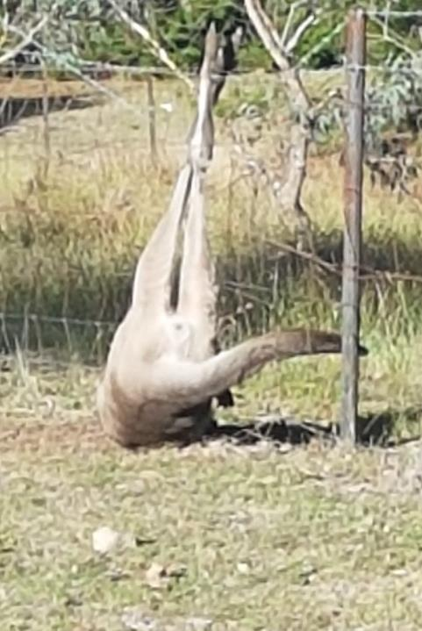
Macropod Fence Injuries: Rescue, assessment, treatment & recovery

Slide 2
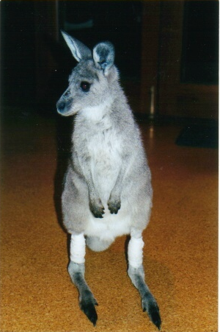
In the beginning
Pints

Slide 3
Fence injury success
98% of all fence injury cases should be brought into care
Many fence injured macropods can have a successful outcome.
Just because a fence injured animal cannot get up after being freed does not mean it will never do so.
Completed around 1500 fence injury rescues. Around 100 this year to date

Slide 4

What we are covering
The rescue
  Equipment
  Plan (types of fences, form of entanglement, mother & joey situation
  Safety, on-site medication, transportation, hypothermia, hyperthermia
Assessment
  Stress, lactic acidosis, hydration status
  Hip Dislocation, fractures.
Treatment
  Fluid therapy & bicarbonate treatment if necessary
  Wounds and ischaemic damage
  Nerve palsy: footdrop, knuckling and leg splaying,
  Medication – pain relief, antibiotics, Baycox, tetanus vax, ivermectin , VAM
Recovery
  Standing practice, bedding, dressing changes

Slide 5
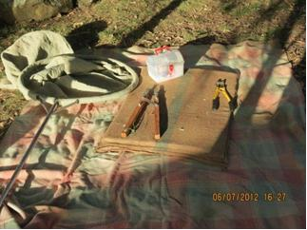
Rescue equipment
Several blankets, nets
Wire cutters/ separators
Large joey bag for at-heel fence hangers
Stretcher
Sedation
Compression bandage
Saline, moisturising/ antiseptic cream, NAD, crepe bandage

Slide 6
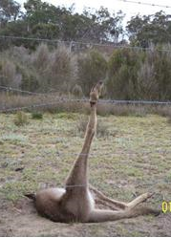
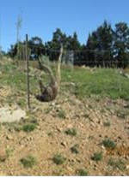
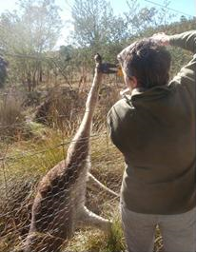
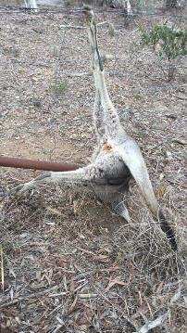
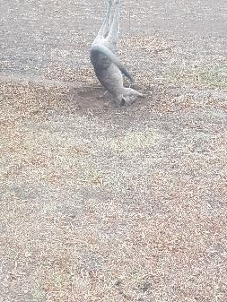
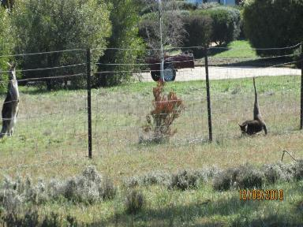

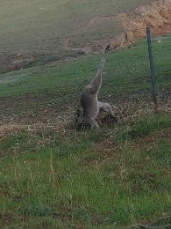
Planning the rescue
Preferably two rescuers
Assess the situation at a distance and apportion tasks
Mother/ joey situations
Types of fences & likely impacts
Approach cautiously but deliberatively
Safety
Note all circumstances

Slide 7
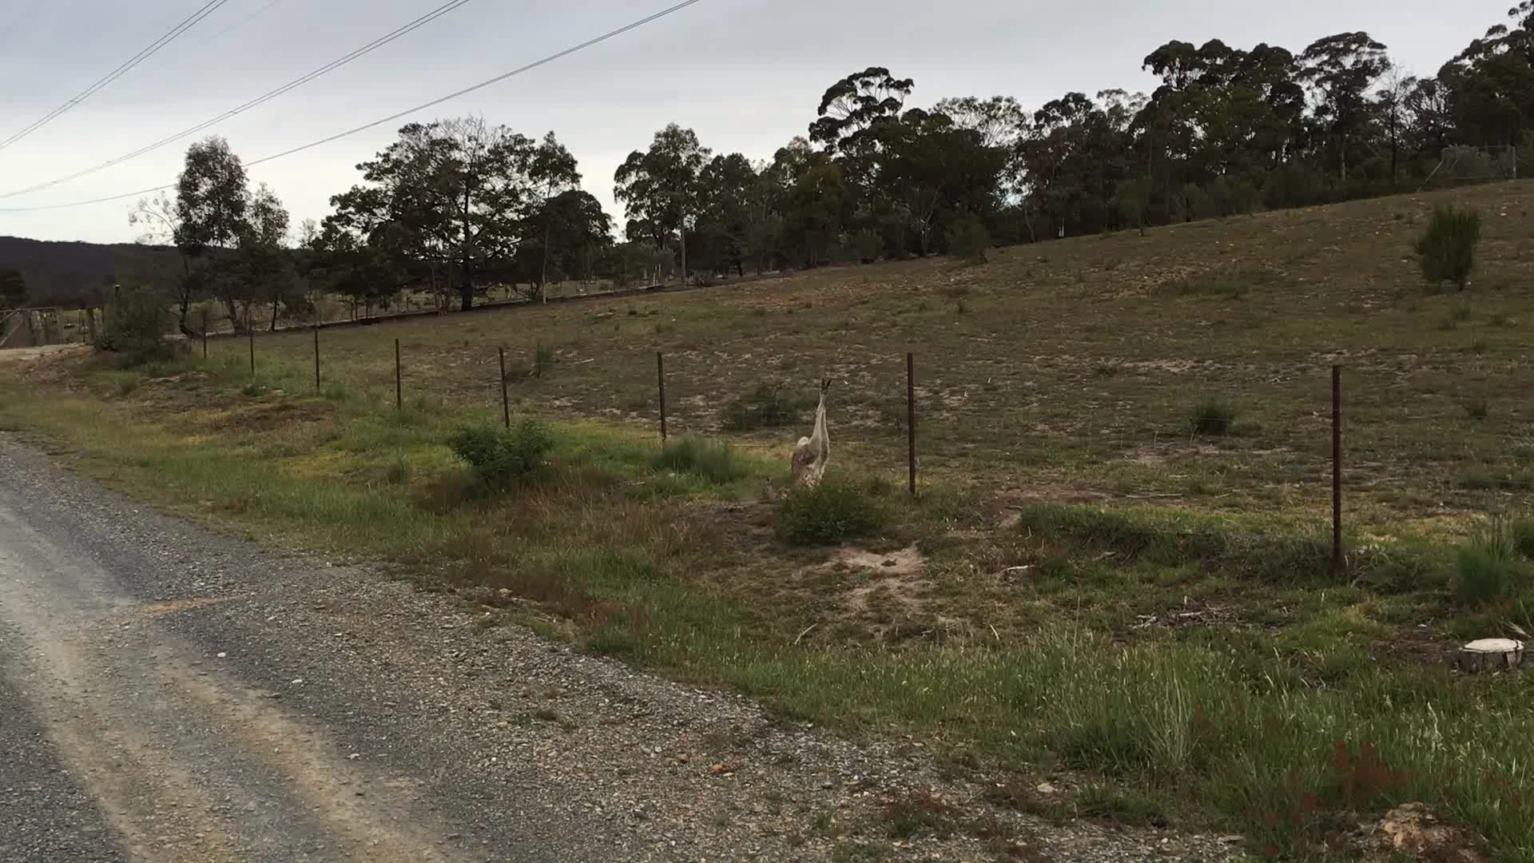

Slide 8
On-site treatment
Decide on sedation requirement, if any.
Treat any significant blood loss from wound (NAD plus crepe bandage).
Prevent contamination of wounds
Flush wounds with saline. Apply a moistening/ antiseptic agent (eg Solugel, Silvazine, etc) Apply NAD, crepe bandage – not too tight and bandage distally.
Initial treatment for hypothermia or hyperthermia.
In transporting the animal consider the possibility of a spinal injury or fracture requiring stabilisation.
Never put an injured animal in a hanging bag for transport. Carry flat on a stretcher.
Cover face to reduce stress.

Slide 9
Key treatment issues
Stress & renal failure prevention
Lactic acidosis
Hip dislocation
Wounds & ischemic damage
Neurological injury
        Fractures

Slide 10

Treatment
Early & intensive fluid treatment is required to treat dehydration and stress, and help prevent renal failure –(Sodium chloride plus Sodium Bicarbonate @ 1ml/ kg SC)
    Subcutaneous (2% - 3%)
    Intravenous (great care has to be used when giving IV fluids to prevent fluid overload. The dose for bicarb if given is much less when given IV)
Vit E/ Selenium 0.05ml/ kg
        Analgesia - Tramadol 1mg/ kg IM
        Wound treatment
        Ultravac 5 in 1 for Tetanus (see Jim Pollock paper))
        Piglet Baycox (0.4ml/ kg) in first week of care.
        Ivermectin (1ml/ 10kg pour on).
        VAM

Slide 11
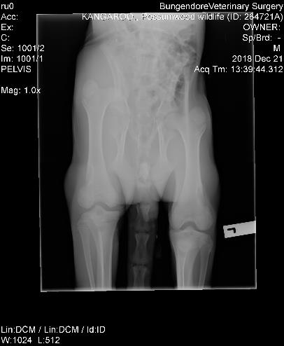
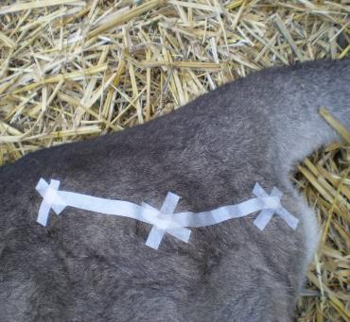
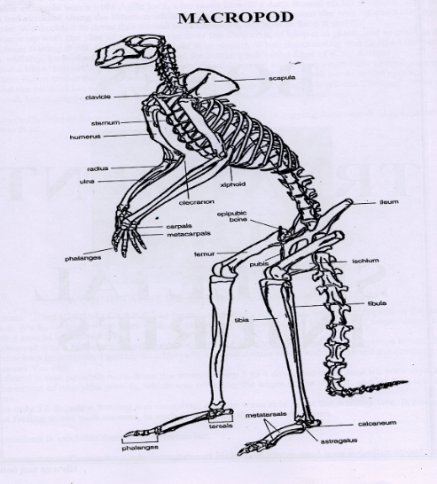
Hip Dislocation

Slide 12
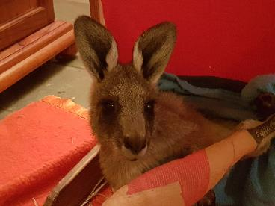
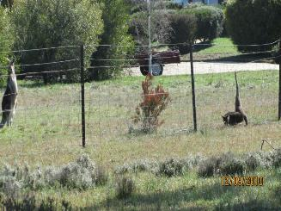
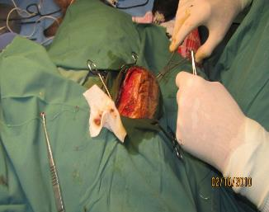
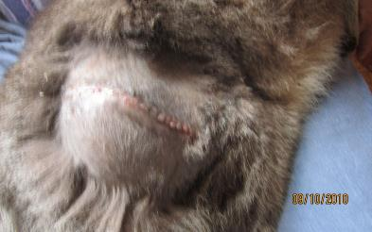
Hip Dislocation: Types of treatment
  Small animal, veterinary treatment is an option
  Closed reduction (traction, abduction, external
  rotation, adduction and internal rotation)
  Open reduction
  Excision arthroplasty – removes head of femur.
  Mobility affected but pain free.
Junior
Tiger

Slide 13
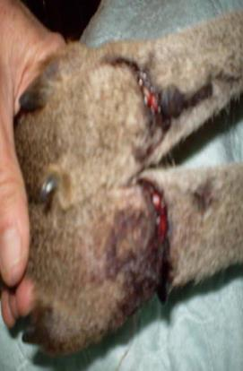
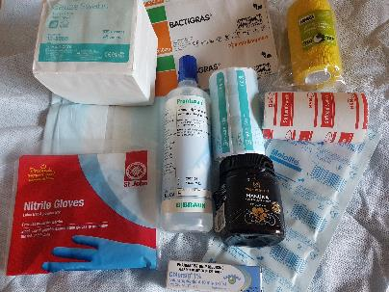
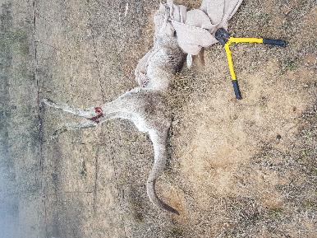
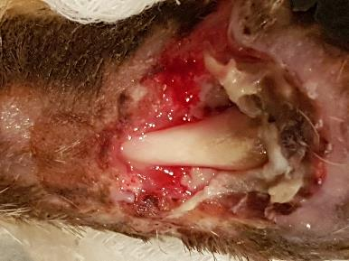
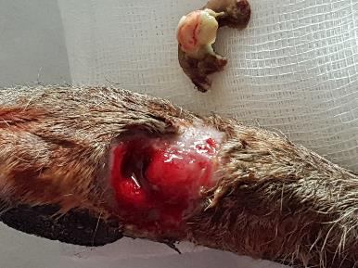
Lacerations
Gumnut
Gumnut

Slide 14
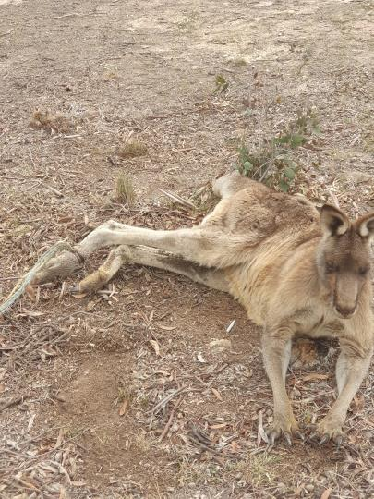
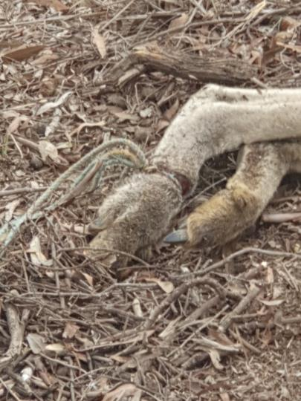
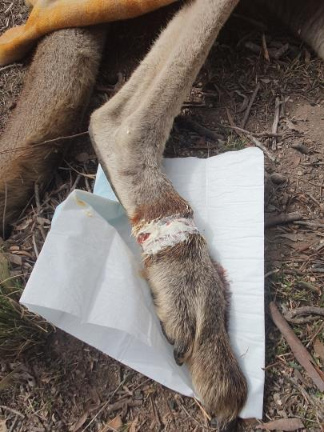
In-situ laceration treatment

Slide 15
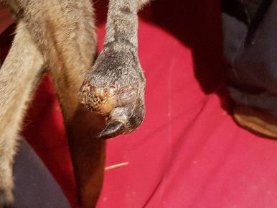
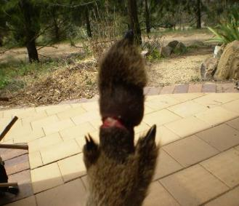
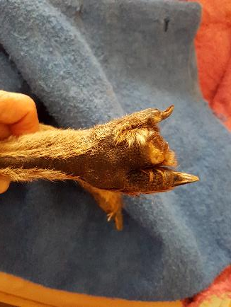
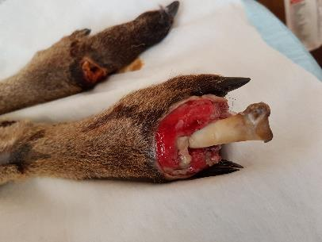
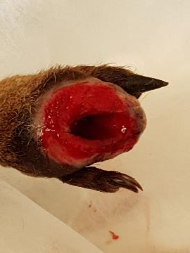
Ischaemic damage

Slide 16
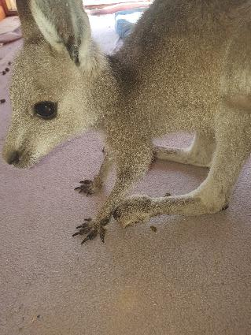
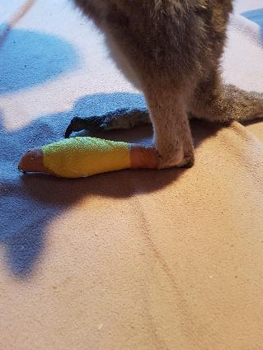
Neurological damage: Sciatic nerve
For knuckling strap in dorsiflexed position
Violet

Slide 17
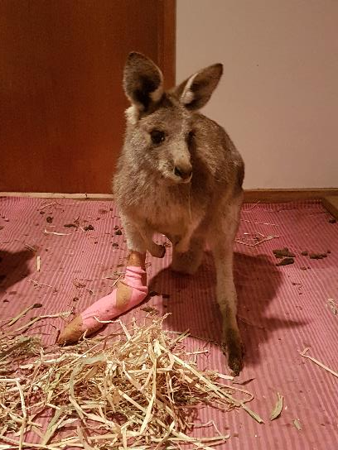
Neurological damage: Sciatic nerve
Sciatic nerve palsy can also result in foot drop - inability to dorsiflex foot. If ankle is not splinted when animal tries to mobilise, severe ankle ligament injuries can occur
Geila

Slide 18
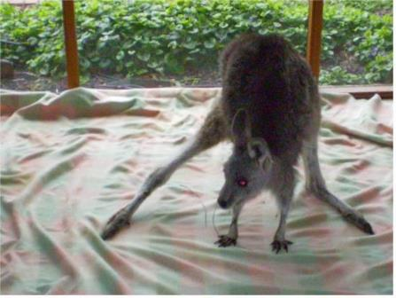
Neurological damage: Obturator nerve
Obturator nerve palsy causes inability to bring leg in towards body (adduct leg) – causes ‘frog-like’ hop.

Slide 19
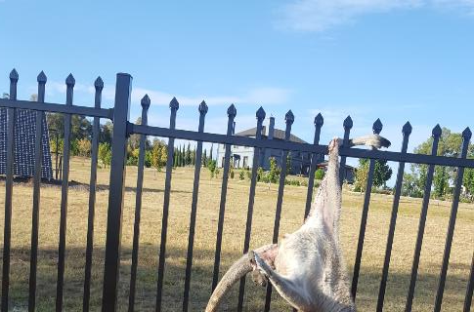

Fractures
Major fractures of the femur and tibia normally result in euthanasia. Often there are minor fractures of the toe and metatarsus. If there is suspicion of a fracture then splinting of the foot is recommended.

Slide 20
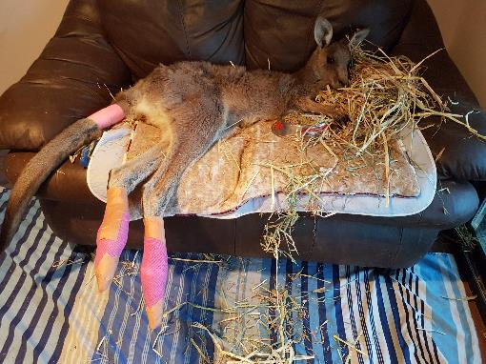
Recovery
Bedding & pressure sores
Standing practice
Wound treatment
Pathology if infection suspected

Slide 21
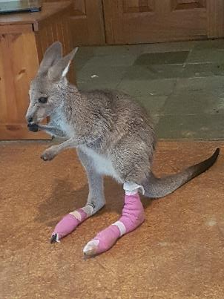
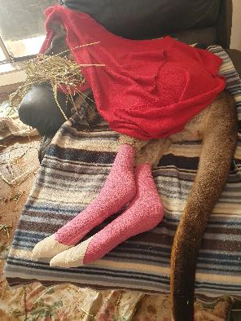
Wound Treatment
Wound cleaning (e.g. NS, Prontosan)
Topical treatment (chlorsig & Manuka honey)
Dressings
Betamox LA 150mg/ ml
0.1 to 0.3ml/ kg SC or
IM, second daily. Or
Oxytetracycline LA,
300mg/ ml, 0.1ml/ kg,
IM third daily

