Slide 1
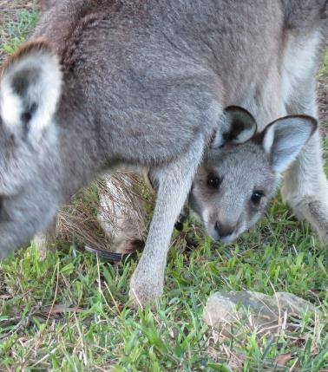
Crystalluria

Slide 2
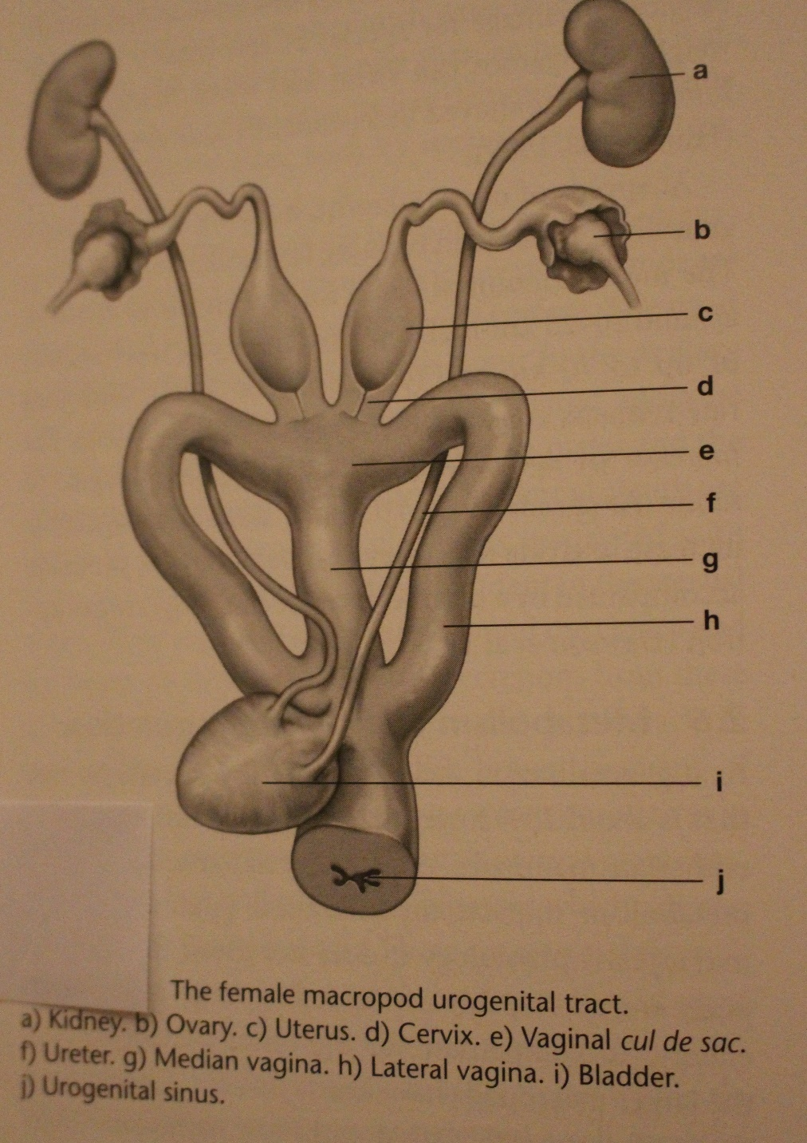

Urology
Females – the bladder opens into the urogenital sinus with vaginae. The external opening is in the cloaca rostrally.
Males – the urethra in male macropods has valve like cusps about 2-3cms proximal to the orifice. Free margin directed towards external urethral orifice – makes catheterisation extremely difficult.

Slide 3
Urinalysis – Multistix 10 SG
Test name | Description
LEU (Leucocytes) | White blood cells. Positive can indicate infection
NIT (Nitrites) | Not normally present in urine. Positive can indicate infection
PRO (Protein) | Positive can indicate kidney pathology, eg renal failure
pH | Macropods eating grass or lucerne have a strongly alkaline urine (High pH 8.0 – 8.5). Joeys on formula have a lower pH
BLO (Blood) | Positive can indicate infection, renal failure or myoglobinuria
SG (Specific gravity) | High SG (1.030) can indicate dehydration. Normal SG (1.010 – 1.020). Low SG (1.000) can indicate renal failure

Slide 4
Crystalluria - causes
Underlying problem is dehydration – diarrhoea, overheating, inadequate water in diet.
Often affects joeys commencing on solids. Grass and lucerne increase the urine PH.
Often associated with a urinary tract infection.

Slide 5

Crystalluria - signs
First sign – often joey scratches at cloaca. With observation straining and dribbling urine noted.
Urine analysis usually shows alkaline (high pH) urine. Can also be blood and leucocytes.
Need to treat quickly to prevent complete blockage
of the urethra.
        Crystals can cause severe inflammation
        in the urethra and the penis can become
        red, tender and swollen.

Slide 6

Crystalluria treatment
Fluids - Oral or SC
Diazepam - 0.05ml/kg (0.25mg/kg) SC. Oral – crush ½ tablet(5mg tablet) and suspend in 3ml boiled water. Use 0.3ml/kg three times daily if needed.
Tamsulosin (Flomaxtra) - relaxes smooth muscle in urethra allowing crystals to pass. 400 microgram tablets. Crush 1 tablet and add 12.5ml boiled water. Use 0.25ml/ kg OD for 1 to 3 days.
Antibiotic – Betamox LA (150mg/ml)0.1 – 0.3ml/ kg SC or IM.
Buscopan (Hyoscine) - 4mg/ ml, 0.1ml/kg BD
Vitamin C - 500mg/ ml injection, 1ml BD or 100mg oral QID to acidify urine
Ilium Neocort – apply to penis. Can use Proctosedyl ointment –available over the counter at pharmacy. To expose penis apply gentle pressure to base of penis.
Emergency treatment – suprapubic tap (removal of urine via abdomen using small gauge -23G needle and great care – veterinary procedure.

Slide 7
Abnormal Urinalysis: Other causes
Myopathy. Myoglobinuria (positive for blood) acid pH.
Renal failure. Urinalysis can show blood, protein and low SG in CRF (1.000). Always do urinalysis in joeys showing failure to thrive
Snake bite. Rhabdomyolysis results in myoglobinuria (positive for blood).
Trauma. MVA can result in blood in urine. Can be microscopic haematuria (positive for blood on urinalysis) or macroscopic haematuria

