Slide 1
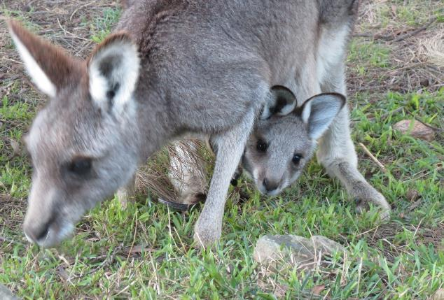

Advanced Macropod Course 2019
Dr Rosemary Austen
rosemaryausten60@gmail.com
0427 204 199
Prof Steve Garlick
Steve.c.garlick@gmail.com
042 888 0564
Stress Myopathy, Lactic Acidosis & Renal Failure; Fence Injuries; Crystalluria; Herpes Virus
" Where is the knowledge we have lost in information? Where is the wisdom we have lost in knowledge? " —T.S. Eliot.

Slide 2
Welcome
Welcome to Country: We recognise the Yuin people as the traditional owners of this land we are on today and we respect their elders past, present, and into the future for managing the land and its animals for thousands of years.
Welcome to the historic town of Braidwood.
We thank the Native Animal Rescue Group (NARG) for hosting this course for us today.

Slide 3
Program
10.00. Welcome
10.15. The emotional lives of animals
10.30. Stress myopathy & lactic acidosis
11.15 Break
11.30 . Renal failure
12.00. Crystalluria
12.30. Lunch
1. 00. Fence injuries
2.15. Herpes virus
2.45. Break
3.00. Open forum or other topics
4.00. Close
Macropod Fence Injuries: Rescue, Assessment, Treatment & Recovery.
11.15. Myopathy & Stress
12.30. Lunch
1.30. Urology
2.30. Kangaroo Herpes Virus
3.30. Open Forum/ Discussion
4.30. Close

Slide 4
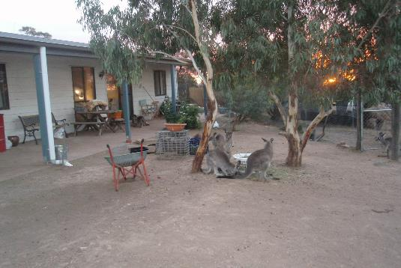
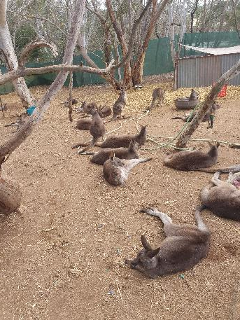
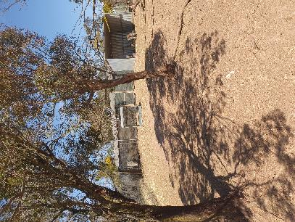
Views of Possumwood: Enclosures

Slide 5
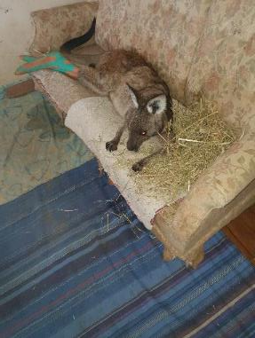
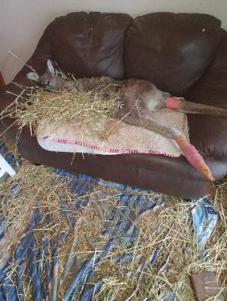
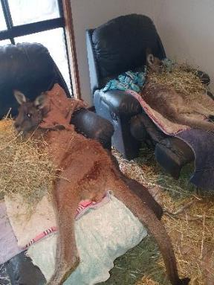
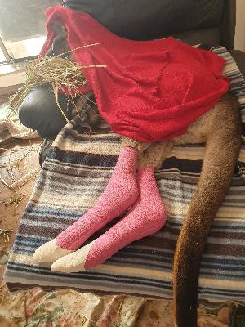
Inside the Possumwood Centre

Slide 6
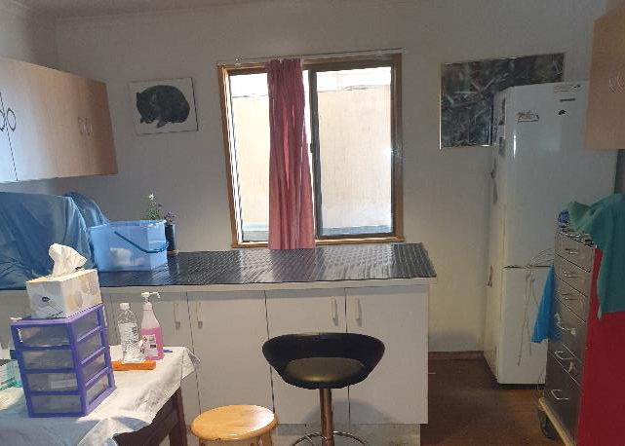
Treatment room

Slide 7
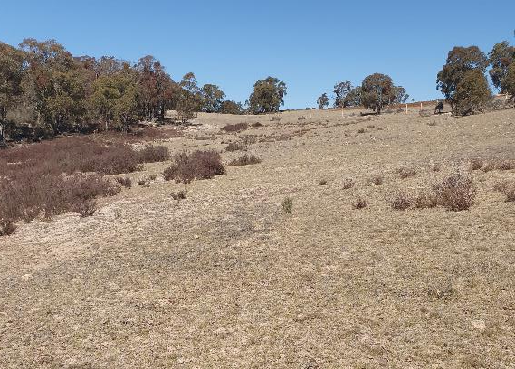
Pre-release enclosure
9 acres of grassy woodland opening on to 1800 acres of private wildlife sanctuary.

Slide 8
Who we are
Self-funded charity with 70 members
Lake George escarpment on southern tablelands
A treatment & recovery facility for native mammals
Three recovery enclosures

Slide 9
What we do
  Rescue native mammals, all ages and sizes, from stressful situations
  Treat difficult injuries and illnesses:
    1/3 fence hangers; 1/3 MVA; 1/3 dog/ fox attack, human harassment & misadventure
  Manage their recovery
  Release them into safe habitat
  Undertake and publish research to enhance wildlife wellbeing
  Training courses in wildlife rehabilitation

Slide 10
Our values
Human exceptionalism has no place
Do no harm
Love & respect them
A ‘being-for’ relationship (‘teacher/ teacher’)
Wildlife knowledge systems
Tran-species learning through engagement

Slide 11
The emotional lives of kangaroos
Emotions are not spontaneous upwellings of arbitrary feelings. They are reactions to events. So if we can correlate emotional reactions with the events that trigger them, we can use these reactions as sources of information to help in recovery.
Emotional life of an animal is just as important for recovery as the physical life.
    The veterinarian cant help you with that. Its your job to engage with it.

Slide 12
Trans-species psychology
Humans and other animals share a common capacity to think, feel and experience situations.
Animals experience complex emotions and are psychologically susceptible to stress as are humans.

Slide 13
Emotional Behaviour
Six neural markers identified for kangaroos (joy, separation, anger, relaxation, nurturance, sexuality)
Two emotional behaviour situations:
  Opportunity seeking & capability realisation in a reinforcing environment
  Fear-induced escaping from a restrictive environment. Failure to escape may give rise to PTSD and psychological extinction

Slide 14
Emotional Behaviour Markers in the Kangaroo
Neural states | Outward indicators (kangaroo)
Joy (play) | Hooning, kicking legs into the air, boxing with kin, chasing kin, eye expression.
Separation, distress (panic) | Vocal, running into objects in panic, eye expression, erect posture, licking forearms, rapid respiratory rate, flared nostrils.
Nurturance (care) | Preening, embracing kin, body contact, protective behaviour by dominant males
Sexuality (lust) | Courtship behaviour, pairing, long-term male/female friendships
Anger (rage) | Vocal, eye expression, posture
Relaxation | Lying on back asleep, mothers relaxing pouch muscle, mothers allowing small infants to exercise outside pouch

Slide 15
Measuring emotional stress in the wild
Observation
Cortisol
Microbiome

Slide 16
Stress & PTSD
Brain processing of a fear- inducing trauma results in dysfunctional emotional and physical behaviour (aggression, anxiety, self-harm, non-engagement)
Inability to distinguish current circumstance with past trauma event.
Assessment tools
    Diagnostic & Statistical Manual of Mental Disorders of the American Psychiatric Association (DSM-V-TR).
    WHO Management of Mental Disorders Treatment Protocol

Slide 17
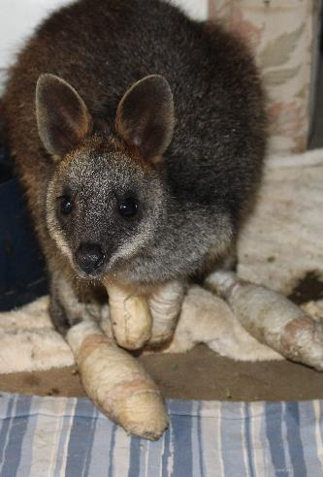
Emotional stress and its treatment in a wild animal
Acute and chronic stress
Tests: neurological behaviour markers, biochemical (cortisol tests using blood, saliva, faecal), microbiome.
PTSD Evidence (DSM V, WHO), eg wild fires, separation anxiety. (Bradshaw, Garlick & Austen)
Treatment to address underlying symptoms of stress: environment context (safe & supportive, kin), medication (anxiolytic eg Diazepam and/ or antipsychotic, eg Haloperidol), ‘being for’ (Bauman) engagement (love & understanding)
Sparkles – burns victim 2017 Carwoola fire. Treated and rehabilitated at Possumwood.

Slide 18
Fight or Flight Response
Amygdala Emotion Centre
Hypothalamus Control Centre
CRF
Sympathetic nervous system
Pituitary Gland
ACTH
Adrenal medulla
Adrenal cortex
Adrenalin
Cortisol
Bloodstream
Neural activity combines with hormones in the blood to constitute the fight or flight response

