Slide 1
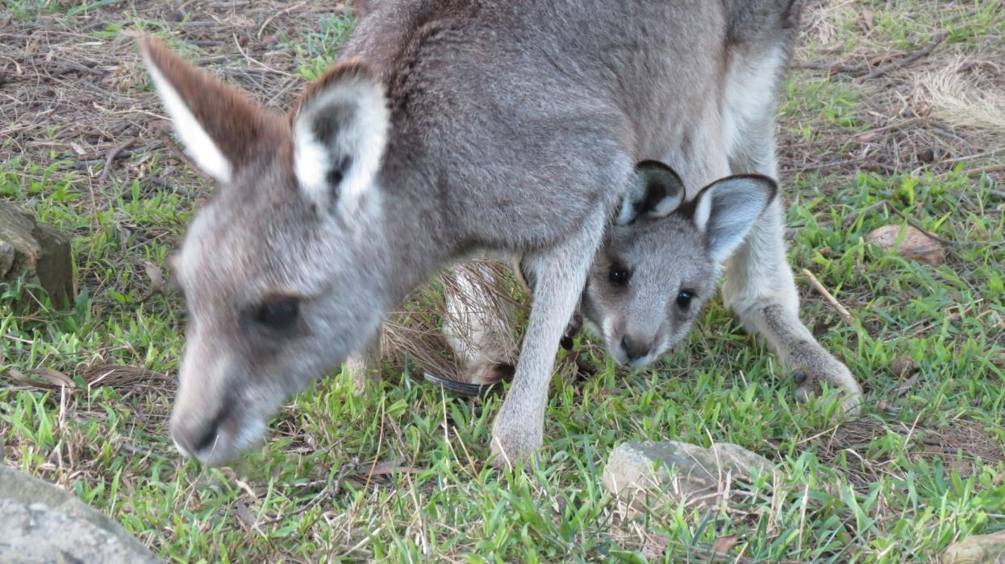

Advanced Macropod Course 2016
Myopathy, Urology, Jaw Problems, Herpes Virus
Dr Rosemary Austen

Slide 2

Thank you
Thank you to all those who attended the course. It was designed to give a basic understanding of the complex biochemical processes which result in the symptoms which we observe in myopathy, as well as current information on other common and significant macropod problems.
I hope carers will find the information useful in caring for wildlife in distress.
The knowledge that wildlife carers accumulate can also assist the ongoing presence of macropod species for future generations to enjoy.
Today’s abundant species is tomorrow’s endangered species.
Keep up the good work and enjoy being a macropod carer.
Rosemary (February 2016)

Slide 3

Advanced Macropod Course 2016
Program
9.00 – 10.30 – Myopathy
10.45 – 12.15 – Urology
1.00 - 1.45 – Jaw problems
1.45 – 2.15 – Kangaroo Herpes virus
2.30 – Finish – Open forum/ discussion

Slide 4
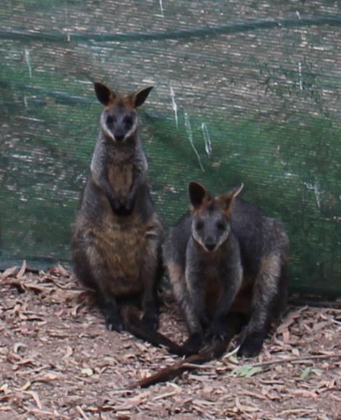
Introduction
Some Guiding Principles for Wildlife Carers
First, do no harm (primum non nocere)
Ensure adequate skills & knowledge
Do not cause unnecessary pain or distress
Understand that evidence of treatments in
wildlife medicine is often anecdotal & not
proven in scientific trials

Slide 5

Stress Myopathy
Major trigger – stress caused by fear or anxiety
Risk increased by physical exertion
Obvious causes – macropod caught in a fence, chased by a motor vehicle or dogs will definitely have stress myopathy. Severity varies
Some causes more subtle, eg change in carer, relocation to release site or certain noises
Personality of the animal also plays a role in whether stress myopathy develops

Slide 6
Important concepts
Two concepts are important in understanding the development of stress myopathy:
Sympathetic nervous system & the hormone adrenalin
Aerobic & anaerobic metabolism

Slide 7
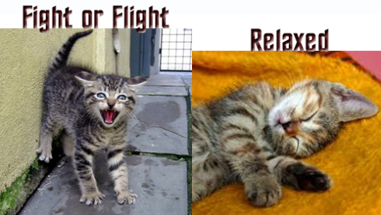
Fear factor
Fear & anxiety trigger the sympathetic nervous system & synthesis & release of adrenalin
Sympathetic - fight or flight
Parasympathetic – rest and digest

Slide 8
Sympathetic nervous system: Effects
Stimulates release of adrenalin
Stimulates glucose release from liver
Diverts blood away from gut and skin
Enhances blood flow to skeletal muscles (1200%), brain & lungs
Dilates bronchioles (airways) of lungs allowing better oxygen exchange
Increases heart rate and contractility of heart cells
Dilates cardiac blood vessels
Dilates pupils.
Useful reference: Energy Systems. http://www.teachpe.com/physiology/energy
_systems.php.

Slide 9
The Adrenalin Rush
Adrenalin contributes to the fight or flight response by:
increasing blood flow to the muscles
increasing output of the heart
pupil dilation
increasing blood glucose

Slide 10
Aerobic metabolism
Glucose
Glycolysis – in cell cytoplasm
ATP (energy source) + Pyruvate + H⁺ (acid)
O₂
Krebs cycle
Electron transport chain –in cell mitochondria
CO₂ (exhaled during respiration) + H₂O + ATP (energy source)

Slide 11
Anaerobic metabolism
Glucose
Glycolysis – in cell cytoplasm
ATP (energy source) + Pyruvate + H⁺ (acid)
Lactate
OR
Creatine kinase (CK)
Creatine phosphate
Creatine + energy – in muscle cells
Phosphate + ADP
ATP (energy source)
Useful reference: http://www.teachpe.com/physiology/energy_systems.php

Slide 12
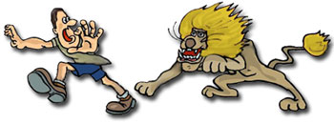
Stress myopathy - consequences
Sympathetic stimulation + Adrenalin + Anaerobic metabolism due to prolonged fear or anxiety & strenuous activity
Consequences
Tissue ischaemia due to reduced tissue perfusion
Lactic acidosis
Muscular ATP (energy source) depletion
Muscle cell damage & consequent release of myoglobin & potassium
Compartment syndrome due to muscle swelling
Acid stimulation of nerve endings in muscles causing muscle pain
Rapid respiratory rate due to metabolic acidosis
Cardiac rhythm disturbance due to hyperkalemia (high potassium)
Hyperthermia (temp > 37 deg C)
Myoglobinuric nephrosis
Acute renal failure if severely dehydrated
Pulmonary oedema

Slide 13
What you might observe (signs of stress myopathy)
Hyperthermia (> 37 Deg C)
Tachypnoea (rapid respiratory rate). H⁺ + HCO₃⁻ CO₂ + H₂O
Acid + Bicarbonate ion Carbon dioxide + Water
(Acidity reduced) (Exhaled during rapid respiration)
Tachycardia (rapid heart rate)
Brown (Coca Cola) urine
Stiff limbs
Pain – macropod appears
uncomfortable (eg stretching hind legs)
Muscle fasciculation
Elevated CK (if able to do a blood test in the acute situation the CK would be significantly elevated.

Slide 14
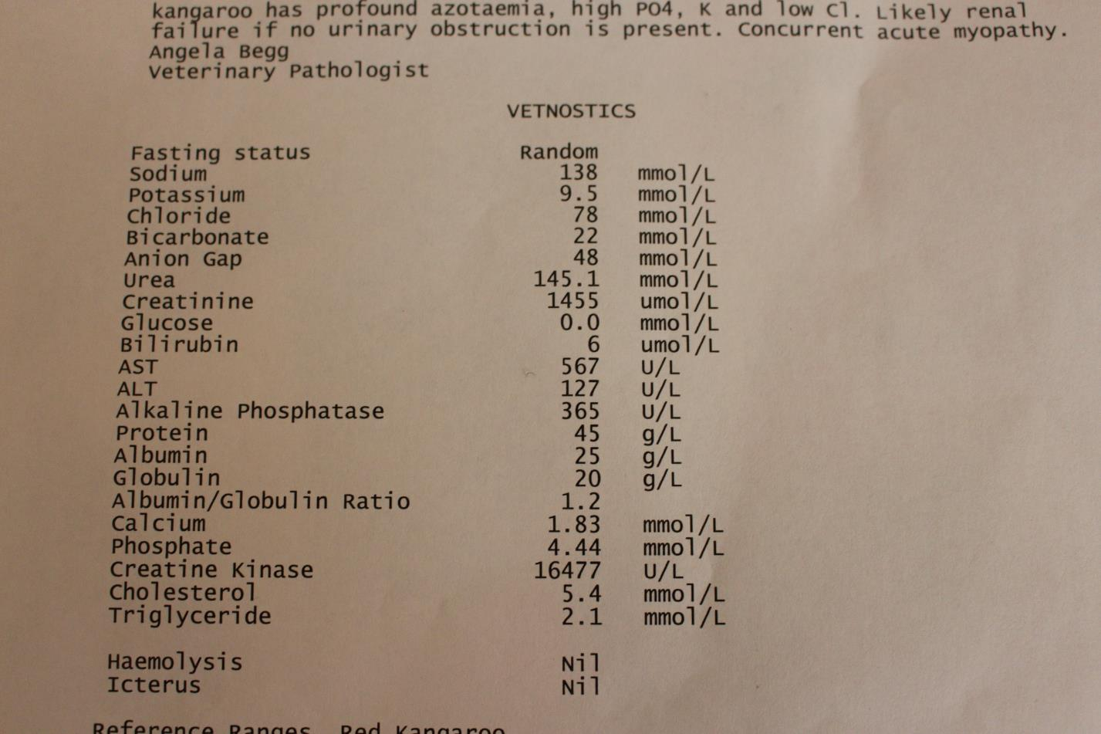
Biochemistry: Ellie - Myopathy & Renal failure
Note elevated creatinine, urea, potassium, creatine kinase, AST

Slide 15
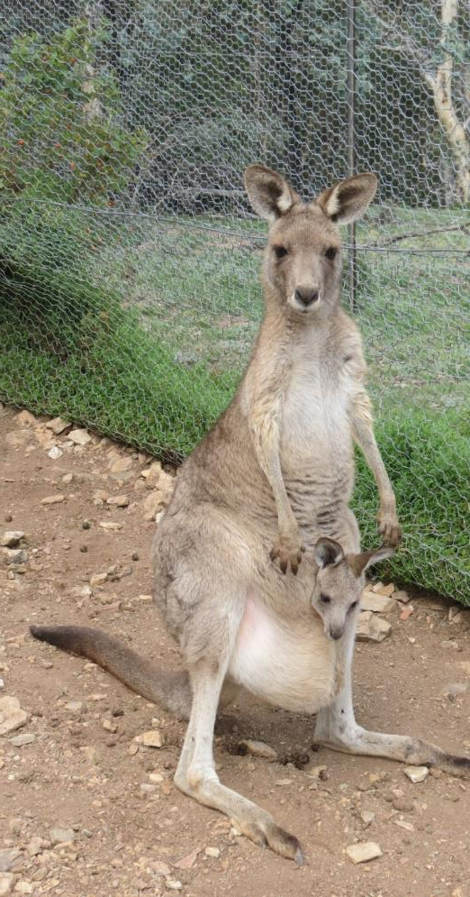

Treatment of stress myopathy
Diazepam (0.25mg/kg IM or SC) – anxiolytic & muscle relaxant
Check temperature (tympanic thermometer - ear)
Offer water – warm or cool, + /- glucose
If hyperthermia (> 37) - cool animal (eg wet towel &
fan). Cool IV fluids most effective but not normally
necessary
If hypothermia (< 35) – warm animal (eg electric throw
rug)
If still tachypnoeic after Diazepam & cooling give
sodium bicarbonate – sterile infusion 8.4% – 1ml/kg made
up to 60ml with normal saline and given SC – see
equilibrium equation earlier slide
        Analgesia – Tramadol (1mg/kg IM) or
        Painstop (1ml/ 2kg oral).
Emu–former fence hanger

Slide 16
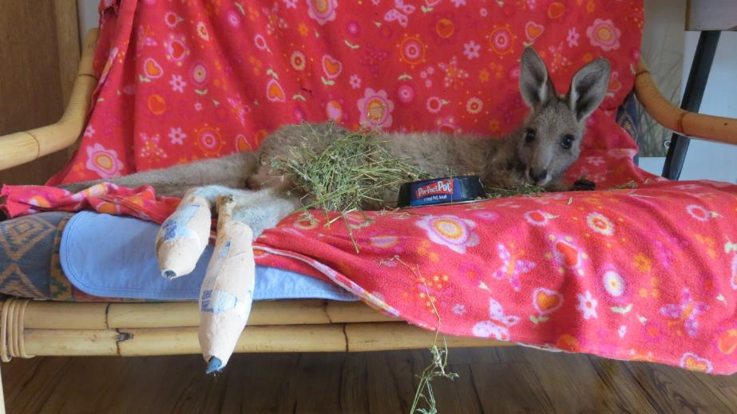
Treatment of stress myopathy (Cont)
Glucose – 1% (1gm/ 100ml water) oral or in fluids
Fluids – 30% by weight SC fluids – normal saline or 4% glucose + 1/5 normal saline
Antibiotics – Betamox LA (0.1 – 0.3ml/ kg SC) &/ or Oxytetracycline (1ml/ 10kg IM)
Vitamin E/Selenium – (0.02 – 0.05ml/ kg IM) if physical exertion involved
Optional – Fluphenazine (Modecate), steroid (Dexamethasone), Frusemide (Lasix) sometimes used
Dantrolene Sodium (1ml/ kg IV) is
mentioned in some texts as a skeletal
muscle relaxant but is expensive.
Bea – fence hanger - required one dose of bicarbonate SC

Slide 17
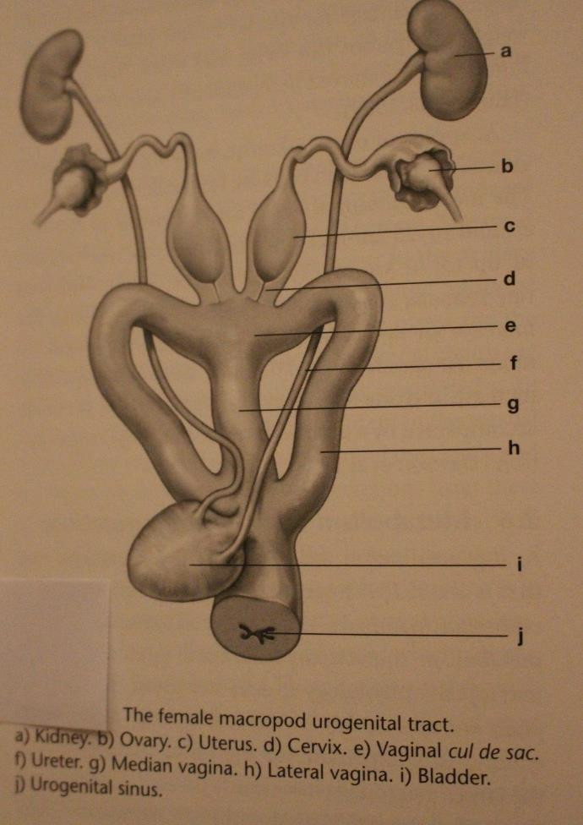

Urology
Females – the bladder opens into the urogenital sinus with vaginae. The external opening is in the cloaca rostrally
Males – the urethra in male macropods has valve like cusps about 2-3cm proximal to the external opening. Free margin directed towards external urethral opening – makes
      catheterisation very difficult even when not blocked by crystals.
Vogelnest & Woods, p.140

Slide 18
Urinalysis – Multistix 10 SG
Test name | Description
LEU (Leucocytes) | White blood cells. Positive can indicate infection
NIT (Nitrites) | Not normally present in urine. Positive can indicate infection
URO (Urobilinogen) | Usually present in small amounts in urine. Strong positive can indicate red blood cell breakdown
PRO (Protein) | Positive can indicate kidney pathology, eg renal failure
pH | Macropods eating grass or Lucerne have a strongly alkaline urine (High pH 8.0 – 8.5). Joeys on formula have a lower pH urine
BLO (Blood) | Positive can indicate infection, renal failure or myoglobinuria
SG (Specific gravity) | High SG (1.030) can indicate dehydration. Normal SG (1.010 – 1.020). Low SG (1.000) can indicate renal failure
KET (Ketones) | Ketones are a product of fat breakdown, eg. Low carbohydrate diet or starvation. Also seen in poorly controlled diabetes
BIL (Bilirubin) | Positive can indicate liver damage or hepatic duct blockage
GLU (Glucose) | Positive can indicate diabetes, steroid treatment or glucose in fluids

Slide 19
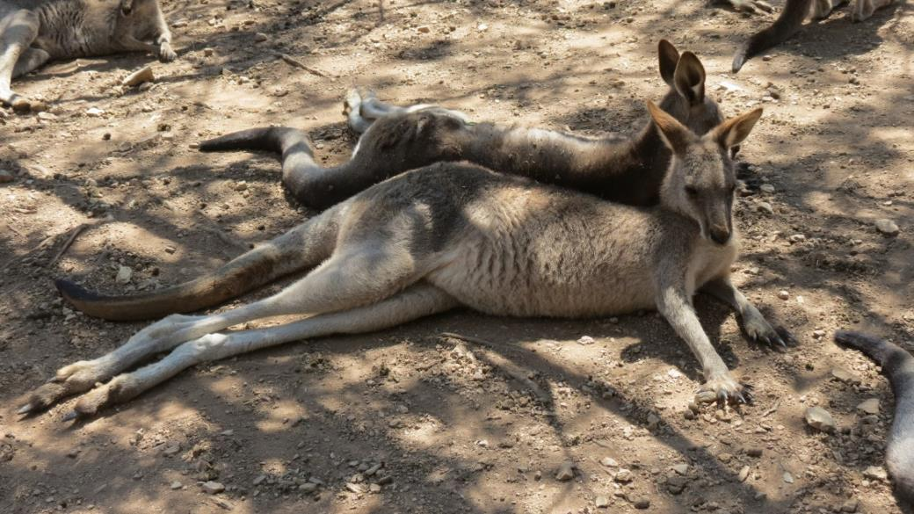

Crystalluria - causes
Underlying problem is dehydration –
diarrhoea, overheating, inadequate water in their diet
Often affects joeys commencing on solids. Grass and Lucerne result in a more alkaline urine.

Slide 20
Crystalluria - signs
First sign – often joey scratches at cloaca. With observation - straining to pass and dribbling of urine noted
Urine analysis usually shows alkaline (high pH) urine. Can also be blood and leucocytes
Need to treat quickly to prevent complete blockage
of the urethra
        Crystals can cause severe inflammation
        in the urethra and the penis can become
        red, tender and swollen.

Slide 21

Crystalluria treatment
Fluids – oral or sub-cutaneous
Acidify urine – to dissolve crystals. Vitamin C – ascorbic acid 100mg oral 4 X daily. IM more effective but invasive – ascorbic acid (500mg/ ml) 0.5 – 1.0ml IM twice daily. Check pH of urine – need to get pH below 7 (5-6 better)
Ilium Neocort (lignocaine, neomycin, hydrocortisone) to penis. Haemorrhoid cream (non-prescription) OK (eg. Proctosedyl ointment). To expose penis apply gentle pressure to base of cloaca
      Buscopan (Hyoscine butylbromide). Oral - crush 1 tablet, suspend in 3ml boiled water. Use 0.1ml/ kg 4 times daily. SC – Buscopan or Spasmogesic 0.1ml/ kg twice daily.

Slide 22
Crystalluria treatment Cont
Diazepam 0.05ml/kg (0.25mg/kg) SC. Oral – crush ½ tablet and suspend in 3ml boiled water. Use 0.3ml/kg three times daily if needed
Tamsulosin (Flomaxtra) relaxes smooth muscle in urethra allowing crystals to pass. Crush ¼ tablet and add 15ml boiled water. Use 0.1ml/kg oral single dose
Antibiotic – Betamox LA 0.1 – 0.3ml/ kg SC
Emergency treatment – suprapubic tap (removal of urine via abdomen using small gauge 23G needle and great care – veterinary procedure).

Slide 23
Urinary tract infection
Joey can appear uncomfortable when passing urine, pass urine frequently, dribble urine and wet its bag
Urinalysis can show leucocytes, blood, protein
Treat with increased fluid intake and antibiotics Gentamicin best but animal needs to be hydrated and IV access required. Can also use Trivetrin, Baytril or Betamox SC or IM.

Slide 24
Abnormal Urinalysis: Other causes
Myopathy. Myoglobinuria (positive for blood), acid pH
Renal failure. Urinalysis can show blood, protein and low SG (1.000). Always do urinalysis in joeys showing failure to thrive
Snake bite. Rhabdomyolysis results in myoglobinuria (positive for blood)
Trauma. MVA can result in blood in urine. Can be microscopic haematuria (positive for blood on urinalysis) or macroscopic haematuria (seen on visual examination).

Slide 25
Mouth & Jaw Problems
Malocclusion
Tooth problems
Mouth infection
Lumpy jaw
Trauma
Deformity

Slide 26
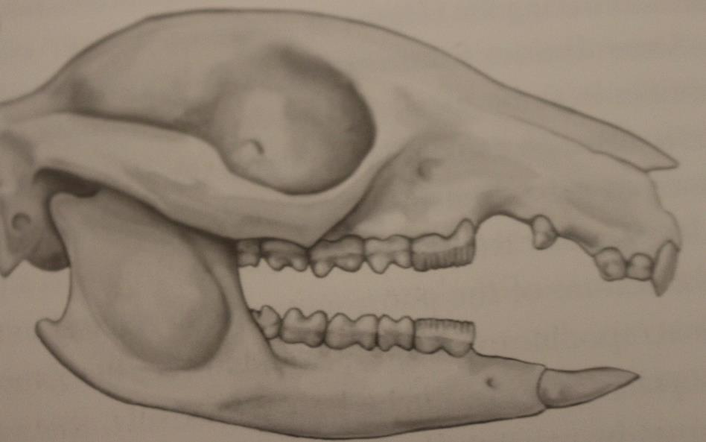
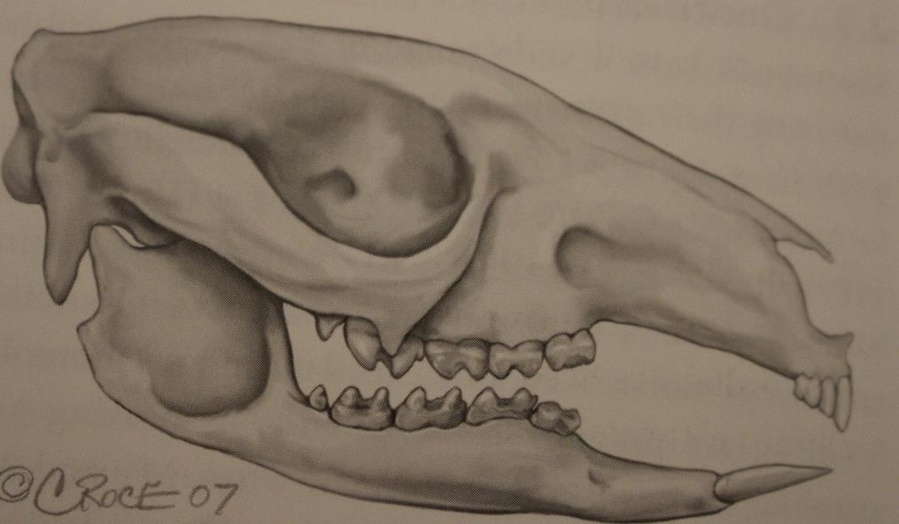
Macropod Skull & Dentition
Macropod browser (eg Swamp Wallaby)
Macropod grazer (eg Eastern Grey Kangaroo)
Vogelnest & Woods, p.136

Slide 27
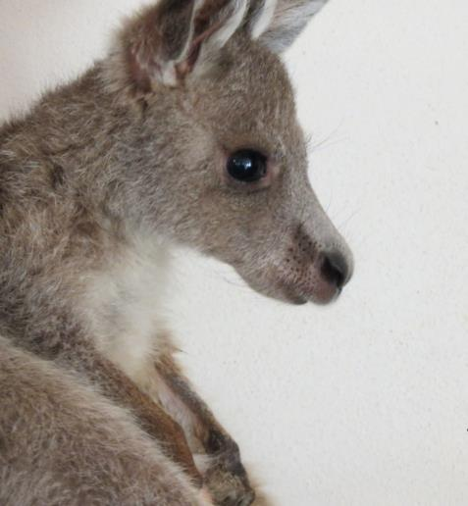
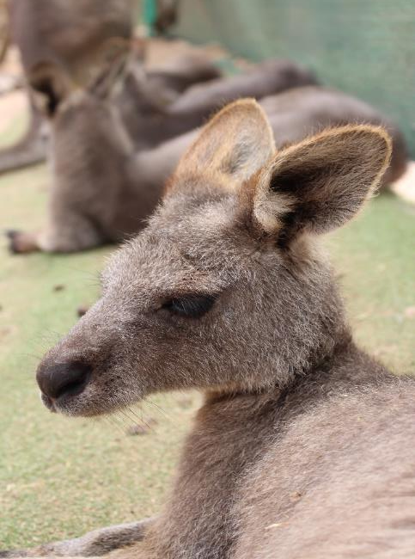
Malocclusion - Spencer
Misalignment or incorrect relation between teeth of upper & lower jaw as the jaws close
Seen in small joeys, especially if they suck part of the body eg toe, wrist or tail causing their mouth to be held open for long periods
Normally joeys would be attached to the teat and sucking most of the time
Bandaging can discourage joeys from sucking body parts. Some joeys will accept teats as a dummy. Offer joeys grass with roots attached
Once joey starts eating hard food and stops sucking the body part malocclusion will normally resolve. Rarely do the teeth need to be filed.

Slide 28
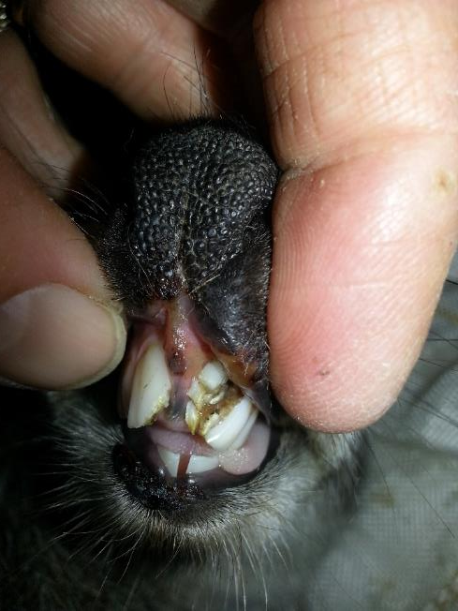
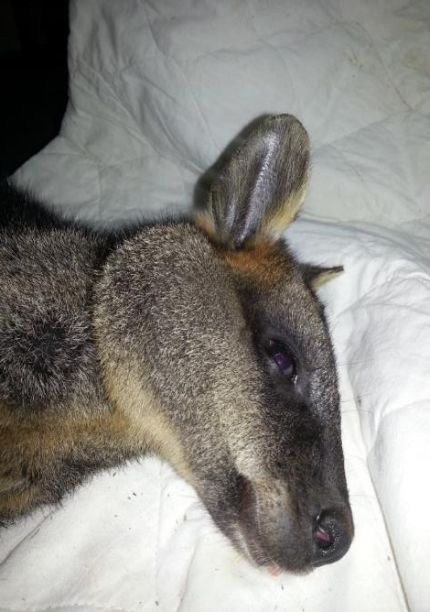
Tooth Problems
Broken teeth. It is recommended that loose or severely broken teeth are removed because of the risk of infection at a later date eg after release
Infected teeth (Mickey). Lump developed on face over one week. X-Ray showed a dental abscess. Tooth extracted, pus drained and antibiotics given - Oxytetracycline IM for 1 month and Metronidazole oral (60mg/kg) for 6 months. No reoccurrence after I year.
Photos courtesy of Helen Stevens

Slide 29
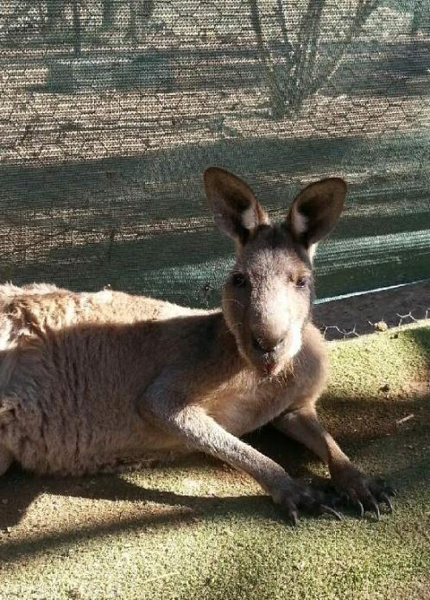
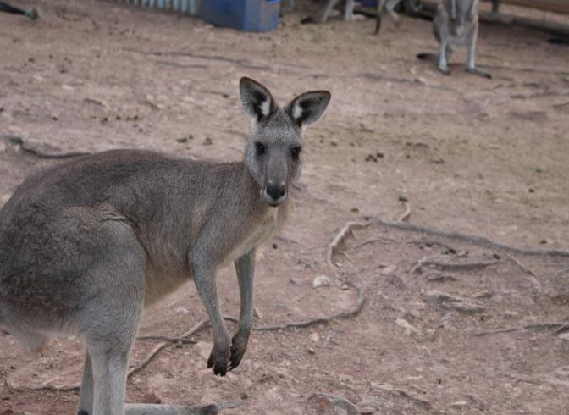
Mouth Infection - trauma - Marley
Marley 30kg male. Given Gentamicin 2mg/kg IM single dose, Metronidazole 20mg/kg SC single dose, Oxytetracycline 1ml/ 10kg IM every three days for three doses, Betamox LA 0.3ml/ kg SC second daily for 3 doses, Metacam 0.4 mg/ kg SC single dose . Rapid recovery seen.
30 January 2016
5 February 2016

Slide 30
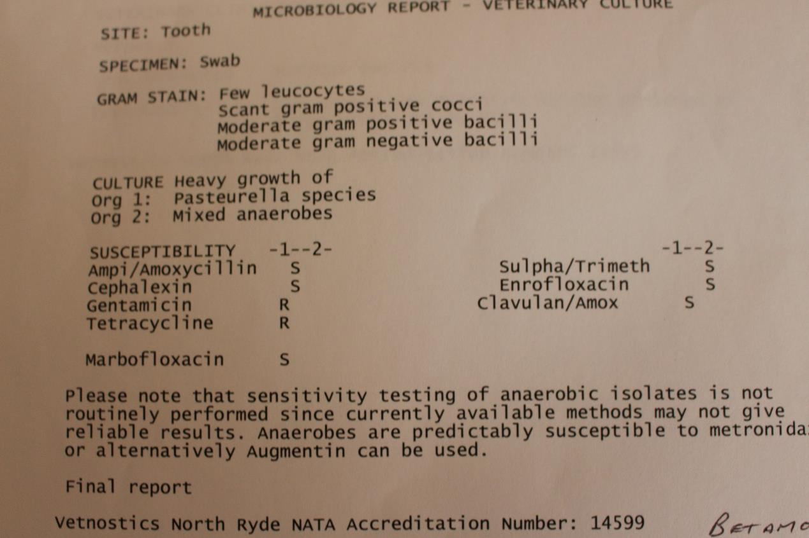
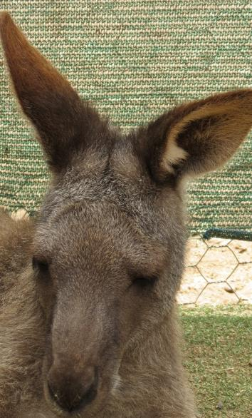
Mouth infection - grass seed abscess - Venus
Venus 20kg female
Surgical debridement indicated a grass seed caused the problem
Given Trivetrin
1ml/ 5kg and
Noroclav
1ml/ 20kg SC daily
for 2 weeks.

Slide 31
Lumpy Jaw
Lumpy jaw is an infection of the bone of the jaw – osteomyelitis
EG kangaroos particularly prone
Initial cause ? Trauma to the soft tissue of the mouth
Bony hard deformity of the jaw evident
There can be a sinus tract
Surgical debridement and long term antibiotics required.

Slide 32
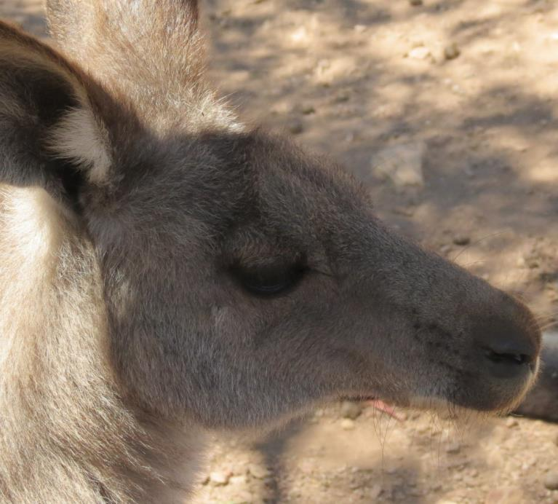
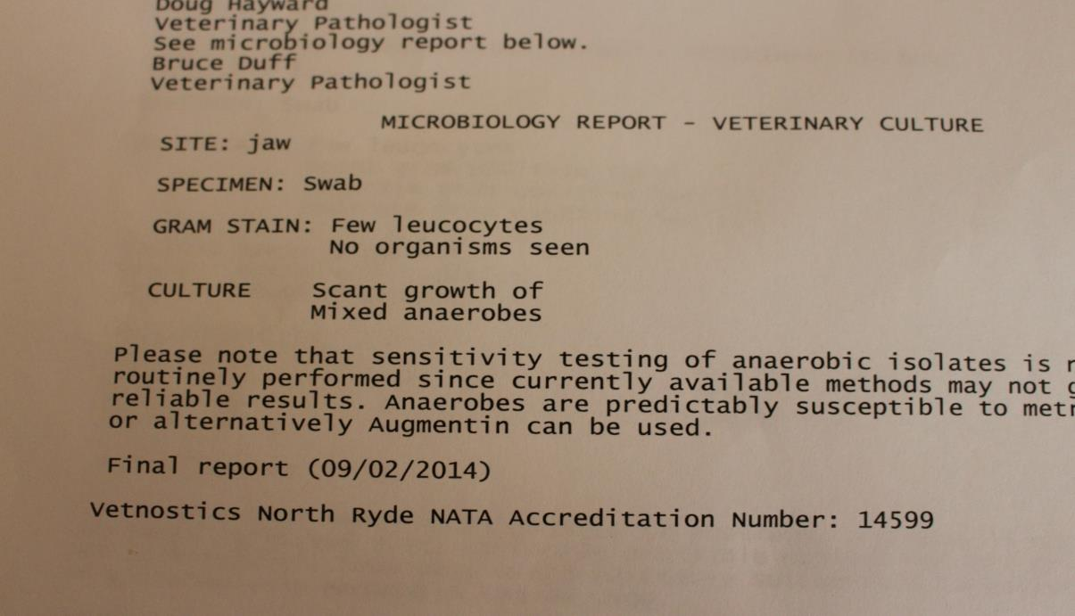
Lumpy jaw - Blanket
Brought back from release site 18 months after release
Treatment - Surgical debridement and long term antibiotics (Metronidazole 20mg/kg IV daily 1 week, Noroclav1ml/20kg daily SC 1 month and Oxytetracycline 1ml/ 10kg every 5 days IM 3 months.

Slide 33
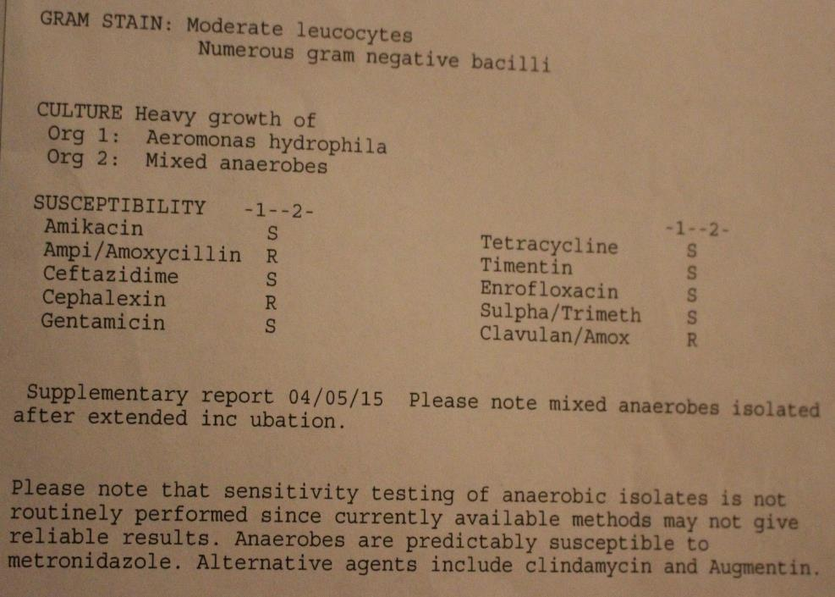
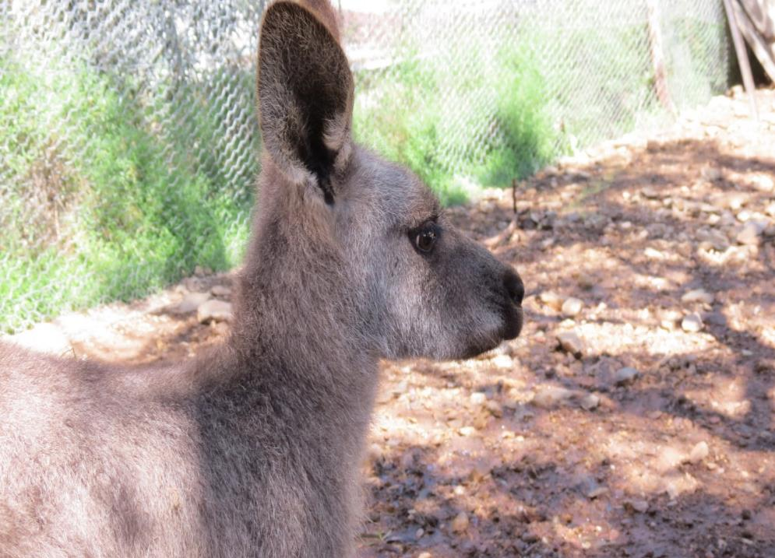
Lumpy Jaw - Sassy
Presented with a bony hard lump rostral mandible. Pus noted to be discharging from a sinus at base of lower incisor
Treatment - surgical debridement and long term antibiotics (Metronidazole 20mg/ kg IV daily 1 week, Noroclav 1ml/20kg SC daily 1 month and Oxytetracycline 1ml/10kg IM every five days 3 months).

Slide 34
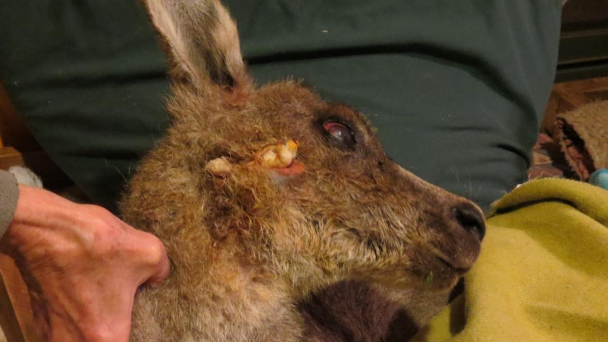
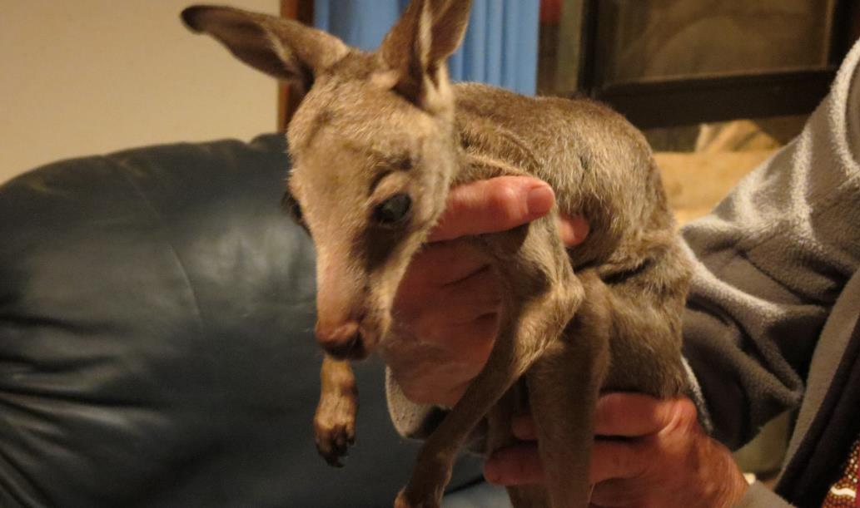
Trauma - Gunshot - Lindy
Lindy – gunshot wound to face, cornea lacerated
Ian – Lindy’s severely dehydrated and malnourished joey

Slide 35
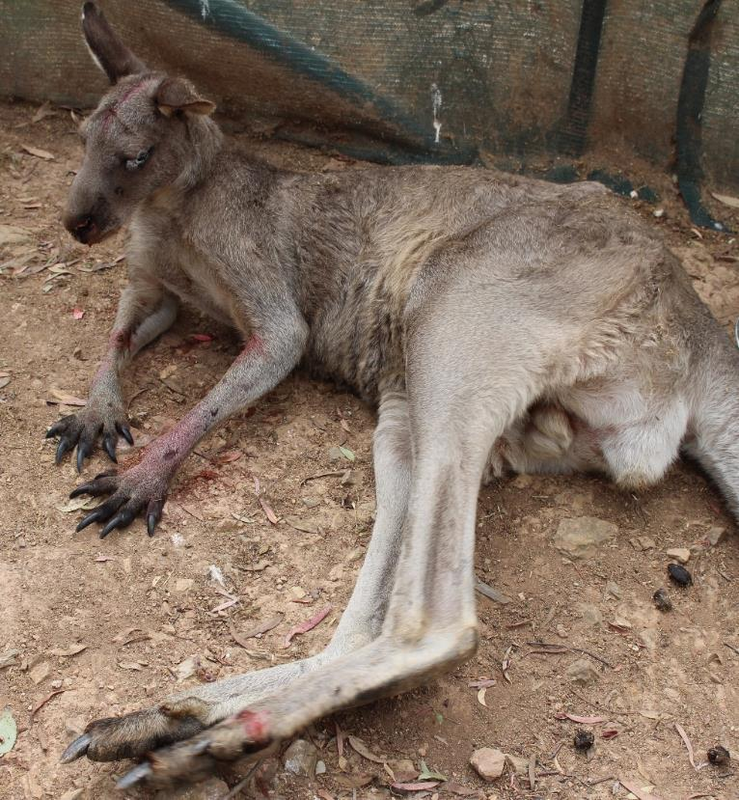
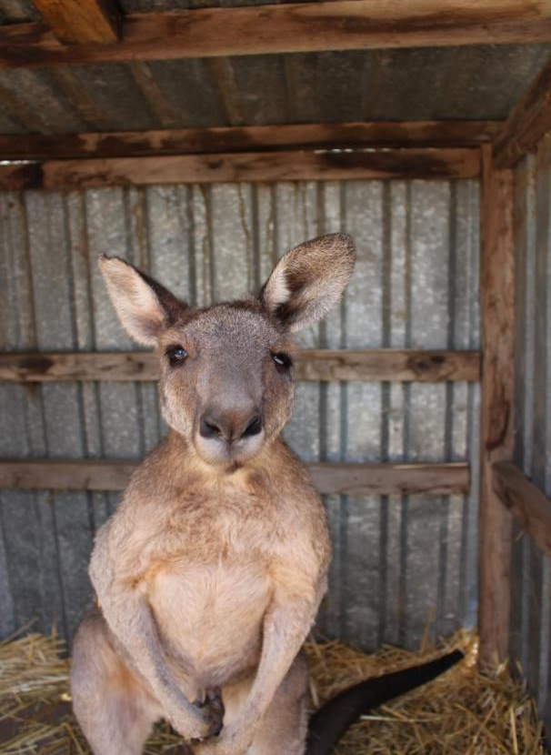
Trauma - MVA - Max
Oxytetracycline 1ml/10kg every five days IM – four doses given. One dose of Modecate (50mg IM) and Dexamethasone (7mg SC) at rescue
Max – fractured zygoma, orbit and hard palate, corneal abrasion and concussion
Mad Max 2 months later, eating well and feeling much better. Now released

Slide 36
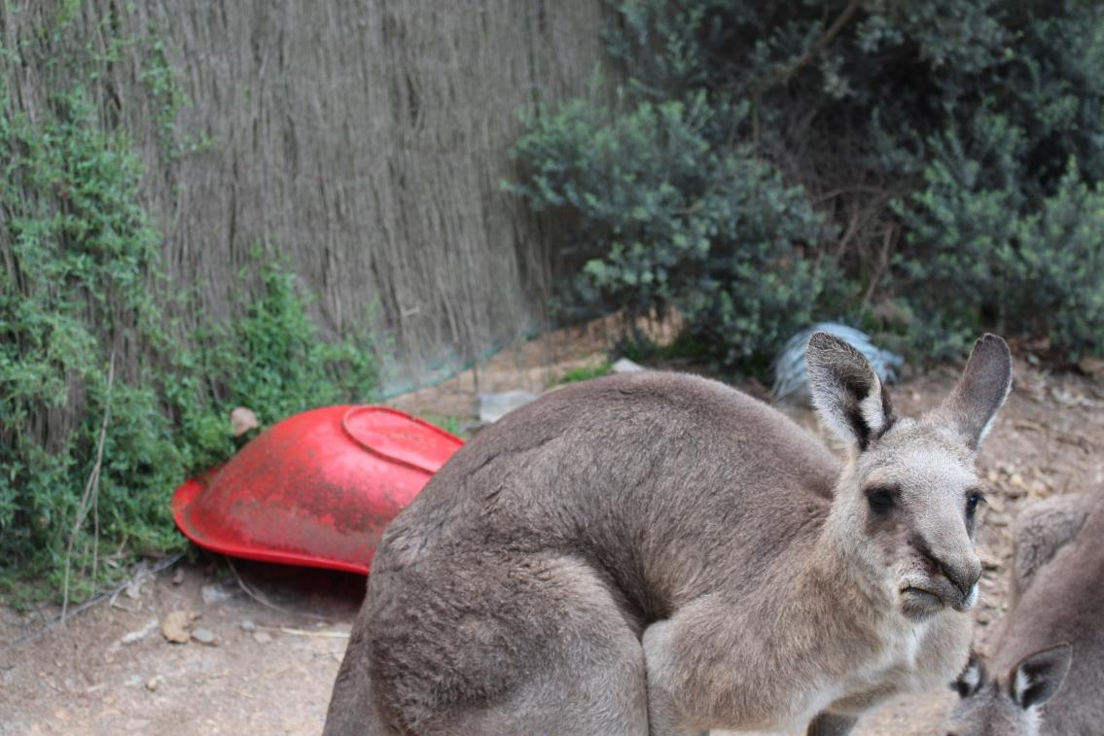
Jaw Deformity - Winston
Jaw deformity developed after his release ten years ago. Still doing well.

Slide 37
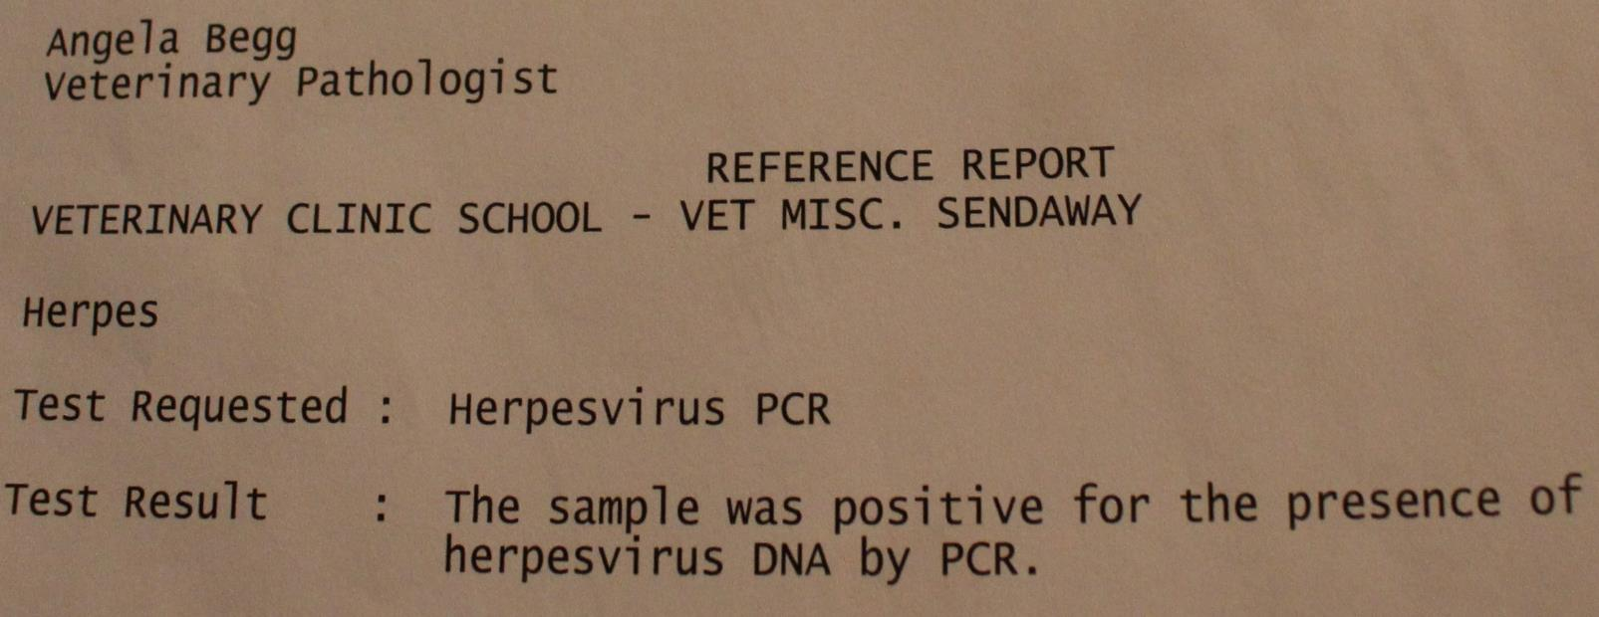
Macropod Herpes Virus
Herpes viruses in humans cause unpleasant diseases such as cold sores, genital herpes, chicken pox, shingles and glandular fever
In macropods both alpha (two strains MaHV – 1 and MaHV – 2) and gamma herpes viruses have been isolated
A Herpes virus PCR indicated that an illness with predominantly respiratory tract symptoms and high mortality rate in small in-care joeys was due to a Herpes virus (see report for Heidi).

Slide 38
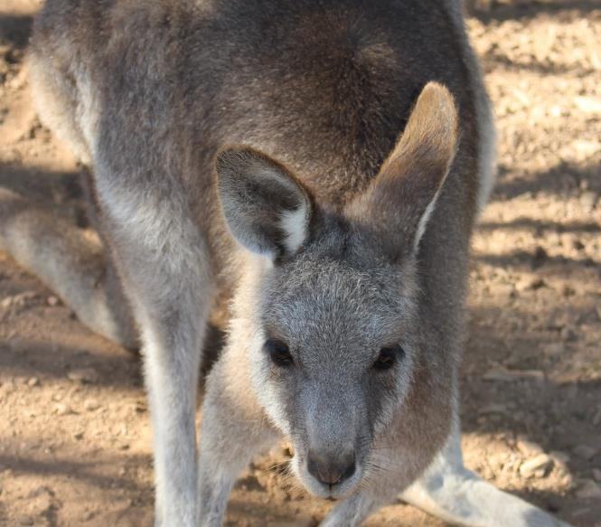

Macropod Herpes Virus
Symptoms – fever, lethargy anorexia, nasal and eye discharge, sneezing, wheezing and respiratory distress
Treatment – Valaciclovir. Crush 1 tablet and suspend in 15ml boiled water. Use 0.5ml/ kg three times a day for seven days
Valaciclovir inhibits viral replication
so it must be used at the first sign of
illness – usually sneezing, watery eyes,
runny nose.
Heidi -12 months after Valaciclovir
treatment and recovery from Herpes virus

Slide 39
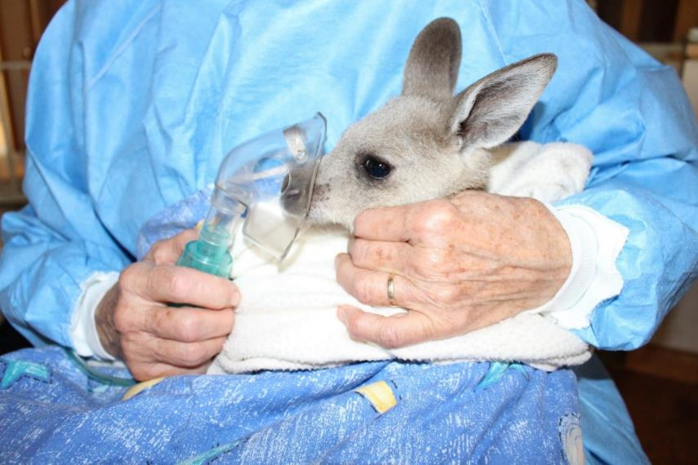

Macropod herpes virus
Joeys who have not been treated with Valaciclovir early in the illness can be treated symptomatically with the following medications – Panadol, Fess nasal saline, Bromhexine, Salbutamol Ventolin via nebuliser),
Amoxycillin and Sucralfate (see handout or Possumwood website for doses).

Slide 40
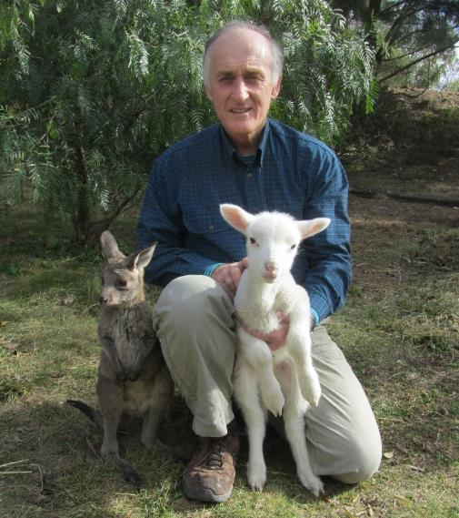
References
Vogelnest, L and Woods, R. (eds). 2008. Medicine of Australian Mammals, CSIRO Publishing.
Ladds, P. 2009. Pathology of Australian Native Wildlife, CSIRO Publishing.
Smith, J A, et al. 2008. Identification and isolation of a novel Herpes virus in a captive mob of eastern grey kangaroos (Macropus
Giganteus). Veterinary Microbiology, vol 129, pp. 236-245.
Energy Systems. http://www.teachpe.com/physiology/energy
_systems.php. Accessed 12 February 2016.
Thanks to Steve for preparing the slides
www.possumwood.com.au

